Slide 1
Radioactivity Basics and Alpha Decay

Slide 2
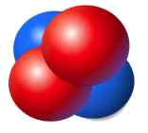
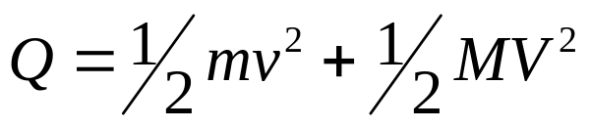
Alpha Decay
An energetic helium nucleus
Commonly called an alpha particle
2 neutrons and 2 protons. 0 electrons
Neutron-proton ratio is too low
occurs most often in massive nuclei (Z > 82)
general reaction:
typical reaction:

Slide 3
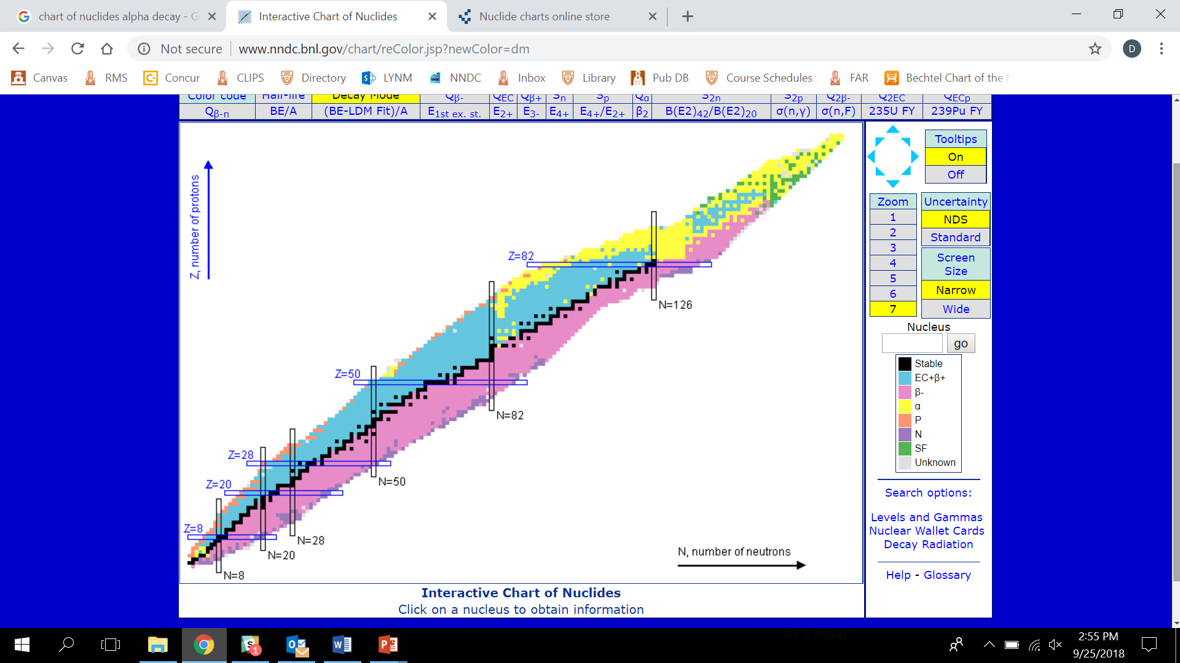

Slide 4
Alpha Decay
conservation of mass must be obeyed:
M_{P} = M_{D} + M_{α} + 2M_{e} + Q
(these should be atomic masses, for convenience)
M_{P} = parent mass
M_{D} = daughter mass
M_{α} = alpha mass
M_{e}=electron mass
Q = total energy released in the transformation.
Q = M_{P} - M_{D} - M_{α} - 2M_{e}
-M_{He}

Slide 5
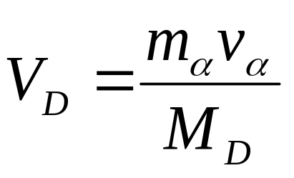
Alpha Decay
conservation of momentum must also be obeyed (use atomic masses here):
m_{α}v _{α}= M_{D}V _{D}
m_{α} = alpha mass M_{D} = daughter mass
v_{α} = alpha velocity V_{D} = daughter velocity
It follows then that

Slide 6
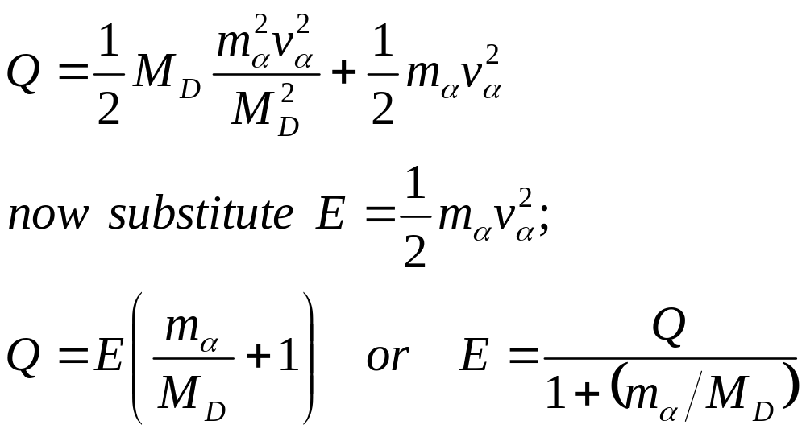
Alpha Decay

Slide 7
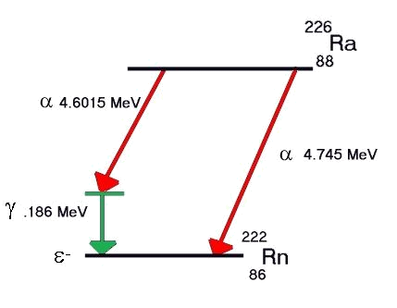
Decay Scheme (Radium-226)
α 4.7844 MeV

Slide 8
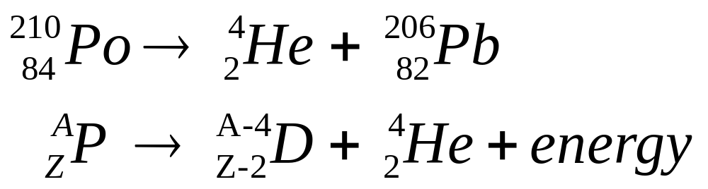
Alpha Emission

Slide 9
Condition for Alpha Emission
M_{P} = M_{D} + M_{α} + 2M_{e} + Q
M_{P} =mass of parent
M_{D} =mass of daughter
M_{α} = mass of a particle
M_{e} =mass of electron
Q = total energy release
M_{P} - ZM_{e} = M_{D} - (Z-2)M_{e} + M_{α} + Q
Q = M_{P} - M_{D} - 2M_{e} - M_{α}

Slide 10
Alpha Decay Kinetic Energy
Example: what is the Q-value of the decay of ²¹⁰Po
Q = M_{Po} - M_{Pb} - M_{α} - 2M_{e}
Q=210.04850-206.0388-4.00277-2 x 0.00055
Q = 0.0058 amu
Q = 0.0058 amu × 931.48 MeV/amu
Q = 5.4 MeV

Slide 11
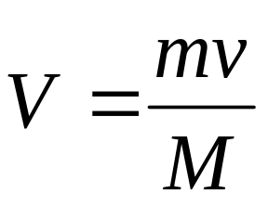
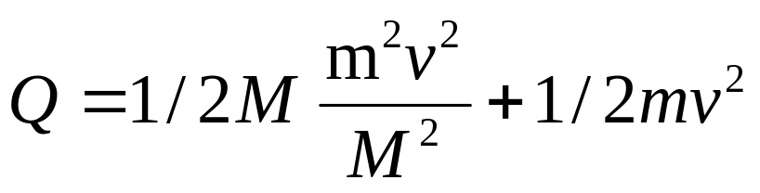
and daughter which recoils:
Q = 1/2 MV² + 1/2 mv²
M= mass of recoil nucleus
m = mass of alpha particle
V = velocity of recoil nucleus
v = velocity of alpha particle
MV = mv

Slide 12
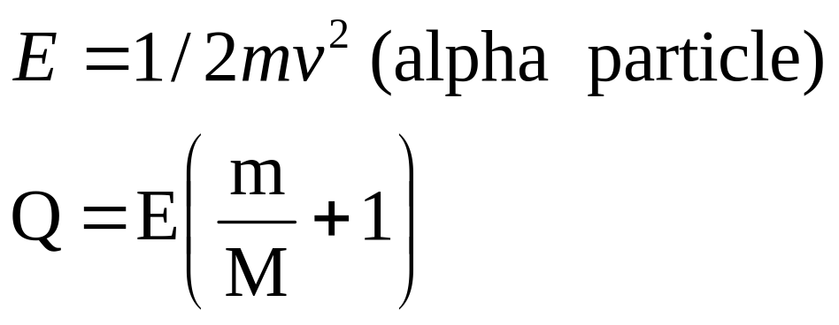
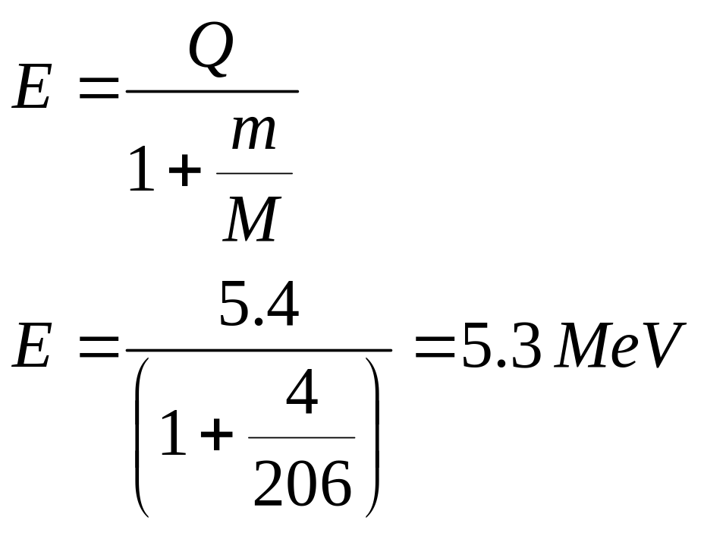
however:

Slide 13
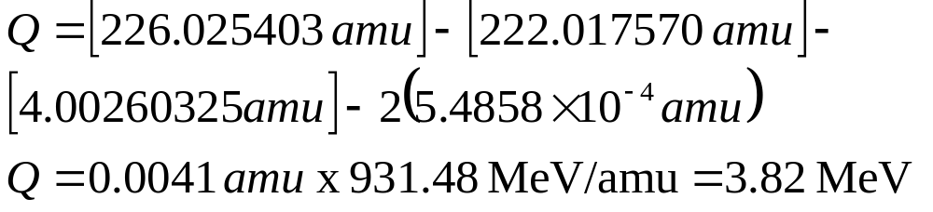
Alpha Decay Kinetic Energy
example: Calculate the Q value for the decay of ²²⁶Ra and the kinetic energy, E_{α}, of the alpha particle.
Q = M_{P} - M_{D} - M_{α} - 2M_{e}

Slide 14
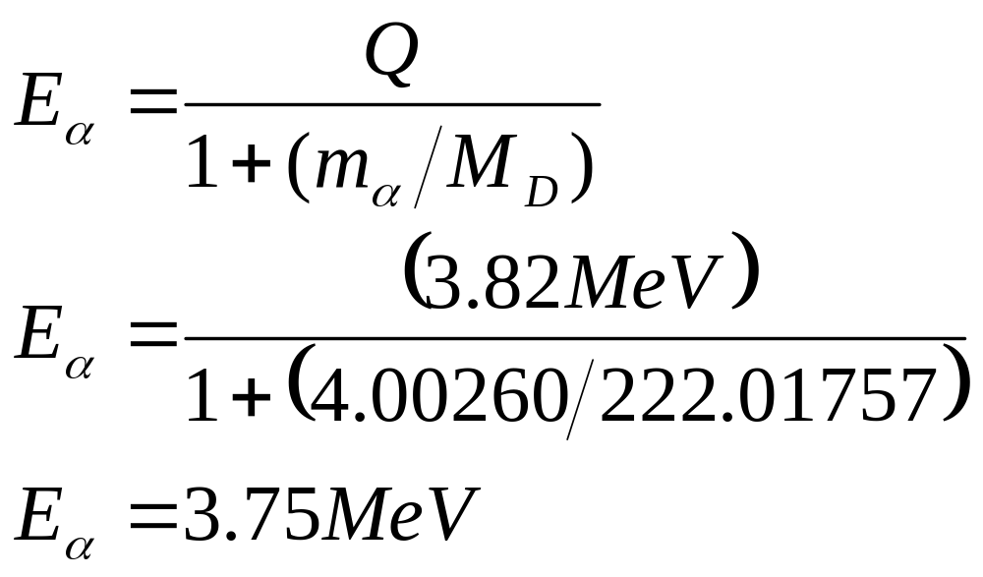
Alpha Decay Kinetic Energy
calculating E_{α} (kinetic energy of the alpha particle):
note that recoil energy is…
  3.82 MeV - 3.75 MeV =0.07 MeV

Slide 15
Alpha Decay Summary
discrete energy distribution
mostly decay to ground state and first excited state of nucleus
most α’s range from 4 - 9 MeV
α’s have a higher LET than other particles because of their mass and charge.

Slide 16
Alpha Decay Summary
dead layer of skin absorbs all alphas; little external dose hazard.
ingestion/inhalation/absorption through an open wound of α-emitting radionuclides causes increased INTERNAL hazard
depending on the element, internal emitters tends to seek various organs and irradiate them (i.e. radium is a bone seeker)

Slide 17
recoil energy: (5.4 – 5.3) MeV = 0.1 MeV
α particles travel at 5% speed of light
loses energy quickly
extremely limited in their ability to penetrate matter
radiation outside the body does not pose a radiation hazard unless airborne
layer of skin sufficient to absorb all radiation

Slide 18
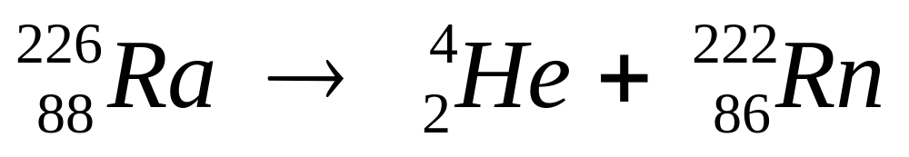
however internally deposited radiation is far more serious
eg

